Slide 1

Let’s Practice
Parts of SPEECH-II

Slide 2

Adjective

Slide 3


Activity Tell each student to expand his/her name using adjective. For Example:- Poonam P- Punctual O- Oriented O- Optimistic N- nice A-Ambitious M- mediocre

Slide 4
Exercise-1.14

Slide 5
Exercise-1.15 Listing three Adjectives:

Slide 6
Exercise-1.16
Pick out all the Adjectives in the following sentences, and say to which class each of them belongs:-
The ship sustained heavy damage.
A live ass is better than a dead lion.
I have not seen him for several days.
There should not be much talk and little work.
The child fell from the great height

Slide 7
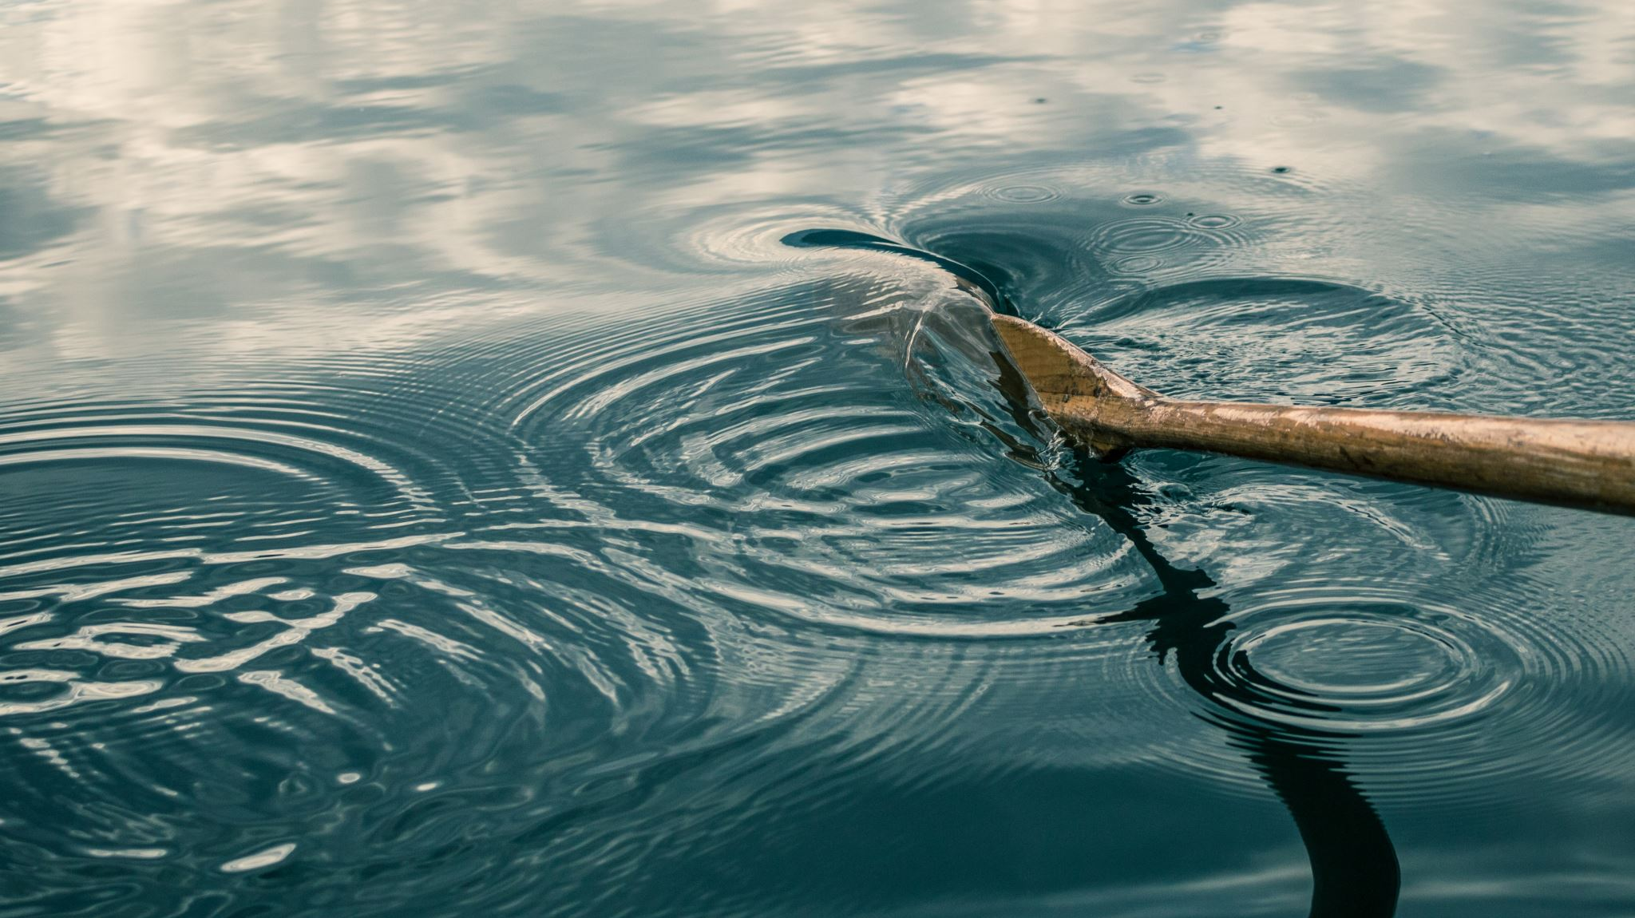
Exercise-1.17

Slide 15
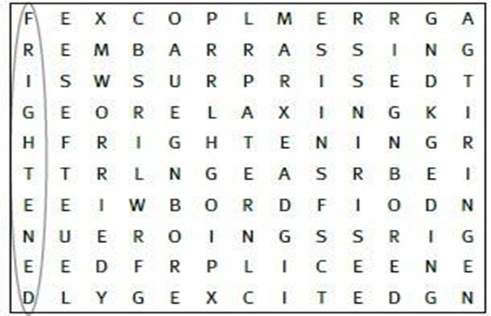
Activity- Find eight adjectives in the word square

Slide 19

VERB

Slide 20
Exercise-1.18

Slide 22
Exercise-1.19
Decide whether the verbs in bold are transitive or intransitive
She was crying all day long.
We showed her the photo album.
The doctor advised me to exercise regularly.
It was raining at that time.
She laughed at the joke.
She gave a cookie to the child.
They slept in the street.
I ate the cherries.
My father doesn't drink coffee.
He always keeps his money in a wallet.

Slide 23
Exercise-1.20

Slide 24
Exercise-1.21

Slide 25
Exercise-1.22

Slide 26
Exercise-1.23

Slide 27
Exercise -1.24
Decide which answer (A, B, C or D) best fits each space.

Slide 29


Exercise-1.25

Slide 45
Success is nothing more than a few simple disciplines, practiced every day…..
Thank you

